Slide 1

The factors that drive home prices
2nd Capstone | Thinkful | November 2019
Maxine Cox

Slide 2
Why does it matter?
Investors are essentially lending money to home buyers in mortgage-backed securities, so the success of the process is dependent on the bank’s ability to identify good investments.
Important factors for investment include:
lending standards for granting mortgages to home buyers
the value of the real estate in question.

Slide 3
So, What affects home prices?
External factors like supply and demand and economic growth have an affect on home prices.
In addition, qualities of the home and property have a big impact on prices.
I hypothesized that some of the biggest driving factors would be:
Year built
Neighborhood
Square Footage
Quality
Condition

Slide 4
About the data
Sale Price
Mean | $ 180,921.20
Standard Error | $ 2,079.11
Median | $ 163,000.00
Mode | $ 140,000.00
Minimum | $ 34,900.00
Maximum | $ 755,000.00
For this analysis, the data set was a sample of 1460 houses in Ames, Iowa that were sold between 2006-2010.
There were 82 columns in the data set, with an approximately even distribution between categorical and numerical data.
This data originally comes from Kaggle: https://www.kaggle.com/alphaepsilon/housing-prices-dataset
Note that the train.csv dataset from this source.
Descriptive statistics from the dataset

Slide 5
Method
This project was done in Excel by utilizing pivot tables and the Data Analysis ToolPak to manipulate the data.
A/A test to determine if sample was biased
Find correlations between numerical variables and sale price
Using correlation results, picked the top correlated variables and ran multiple regression to further drill in and find variables with the most significance.
Ran regression, taking out insignificant variables until all p-values were <.05.
Ending r² = 0.79
Ran Student’s t-tests on resulting variables to check my work.

Slide 6
Methods Explained
Regression and correlation:
Further notes: Due to limitations of the dataset and tools used, it was deemed too labor intensive to consider every variable exhaustively, since converting categorical variables to numerical data for use in correlation and regression is inefficient in Excel.
Due to this, the correlation and regression process described was only carried out on numerical data sets.
T-tests:
Picked out a handful of categorical variables based on research and conducted Student’s T-tests to test the significance of their effects on home prices.

Slide 7
The Results
From these methods, I distilled 10 of the top factors that drive home prices:
Top Factors that drive house prices
1. Overall Quality
2. Garage Cars
3. Fireplaces
4. Year Remodel added
5. Year Built
6. Above Ground Living SF
7. Masonry Veneer SF
8. Total Basement SF
9. Kitchen Quality
10. Neighborhoods
Today, we will review the top 5.

Slide 8
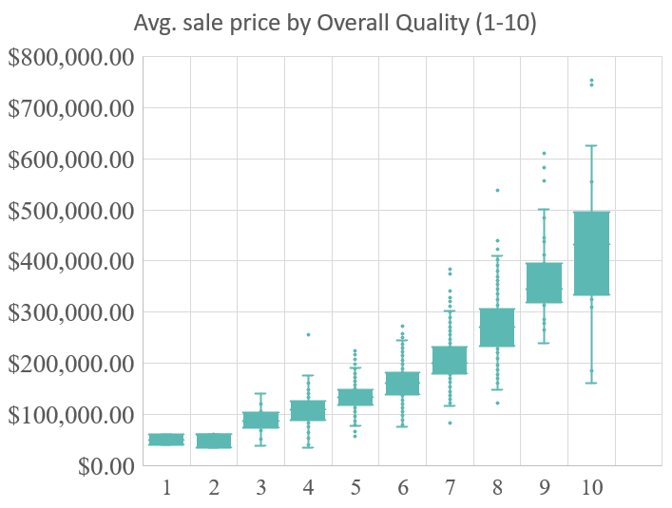
Top driving factor: Overall Quality
Correlation: 0.79
T-tests: H₀: p = 0, H₁: P < .05
Houses with quality score 10 vs. 9:
P = 0.087
Quality score 10 vs. 8:
P = 0.0004
P < .05 at .0004

Slide 9
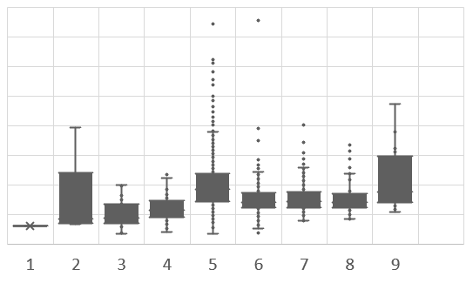
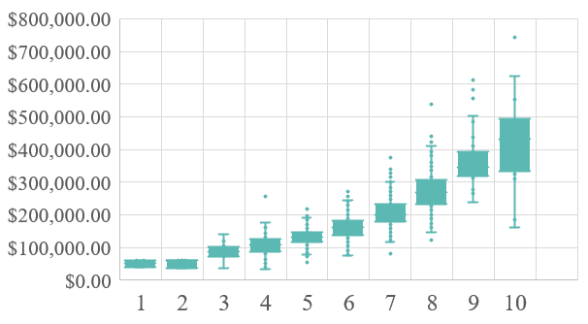
Comparison of Overall quality vs. Condition
Although Overall Quality is the top factor for predicting sale price, the same is not true for the Overall Condition of houses:
Overall Quality
Overall Condition (y-axis same scale)

Slide 10
Garage cars
Correlation: 0.64
T-test: H₀: p = 0, H₁: P < .05
Houses with 3 car garage vs 4 car garage:
P = 0.005
P < .05 at .005

Slide 11
FirePlaces
For fireplaces, t-tests don’t show significant differences between with 2 and 3 fireplaces.
The results from the regression showed that the relationship between number of fireplaces and sale price had the 3rd highest coefficient.

Slide 12
Runner ups: also very significant
Year built and year remodeled are two details that are easy to glean and hold a lot of predictive value.
A sharp increase in sale price can be seen in both charts following the turn of the century.
Average Sale Price by year remodel added
Average Sale Price by year built

Slide 13
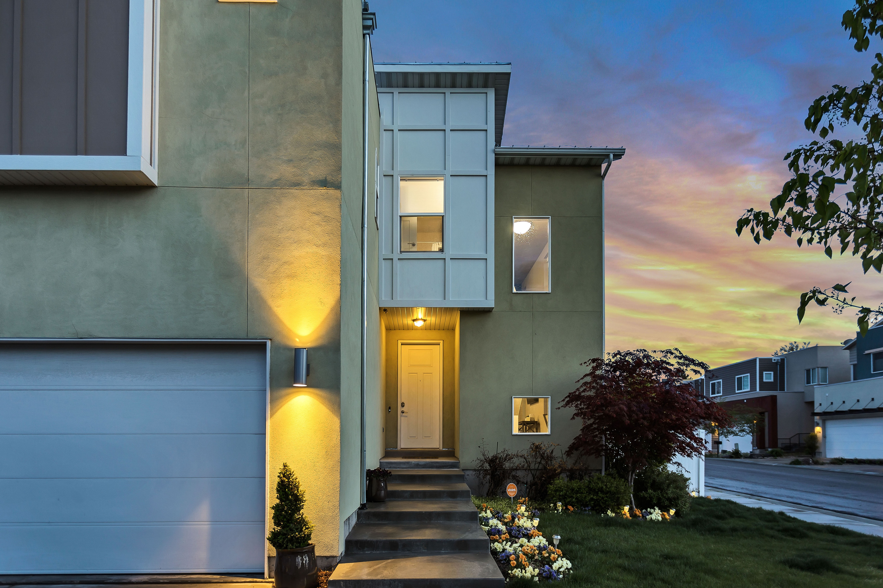
Conclusion
To bring it home, when making decisions for allocating the firm’s investment dollars, separate the signal from the noise by looking at the data on what factors drive home prices.
Recommendations:
When assessing a property for investment, take into account these factors, in order of significance from the regression:
1. Overall Quality
2. Garage Cars
3. Fireplaces
4. Year Remodel added
5. Year Built
6. Above Ground Living SF
7. Masonry Veneer SF
8. Total Basement SF
9. Kitchen Quality
10. Neighborhoods

Slide 14



THANK YOU
Maxine Cox
239-272-7915
mhcoxmail@gmail.com
www.maxinehcox.com

